Slide 1
Throwing Injuries in the Adolescent Athlete
James T. Monica, MD
February 21, 2018

Slide 2
I have no disclosures

Slide 3
Epidemiology
Sports participation, circa 2000
>25 million school-sponsored
>20 million extracurricular
Unique considerations in children/adolescents
Skeletal immaturity
Muscle strength, coordination
Poor technique, mechanics
Overuse, high intensity

Slide 4
Sports-Specialized Intensive Training and the Risk of Injury in Young Athletes: A Clinical Case-Control Study.
1200 youth athletes
Early specialization in a single sport is one of the strongest predictors of injury
Athletes in the study who specialized were 70% to 93% more likely to be injured than children who played multiple sports
Am J Sports Med. 2015 Feb 2
Jayanthi NA¹, LaBella CR², Fischer D³, Pasulka J⁴, Dugas LR³

Slide 5
What is sport specialization?
High volume and intensity of training
Duration of training at a young age
Minimal rest or time off
Structured training with emphasis on physical development
Exclusion of other sports

Slide 6
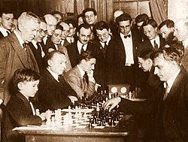
Theory of sport specialization
Based on interpretation of a study by Ericsson from 1993
High volumes of deliberate practice at a young age was the strongest predictor of becoming an expert performer
“10,000 hour rule”
Expert status for musicians, mathematicians, and chess players NOT athletes
No specific number of hours was proven as enough to master a task.

Slide 7
Who specializes and why?
Children who are older and slightly more physically developed are more likely to specialize early.
Potential for scholarships or professional contracts
Only 0.2-0.5% of high school athletes ever make it to the professional level
6% high school athletes will play in the NCAA
Positive feedback from parents and coaches
Parents are strongest influence on the initiation of sports
Coaches are the strongest influence for specialization

Slide 8
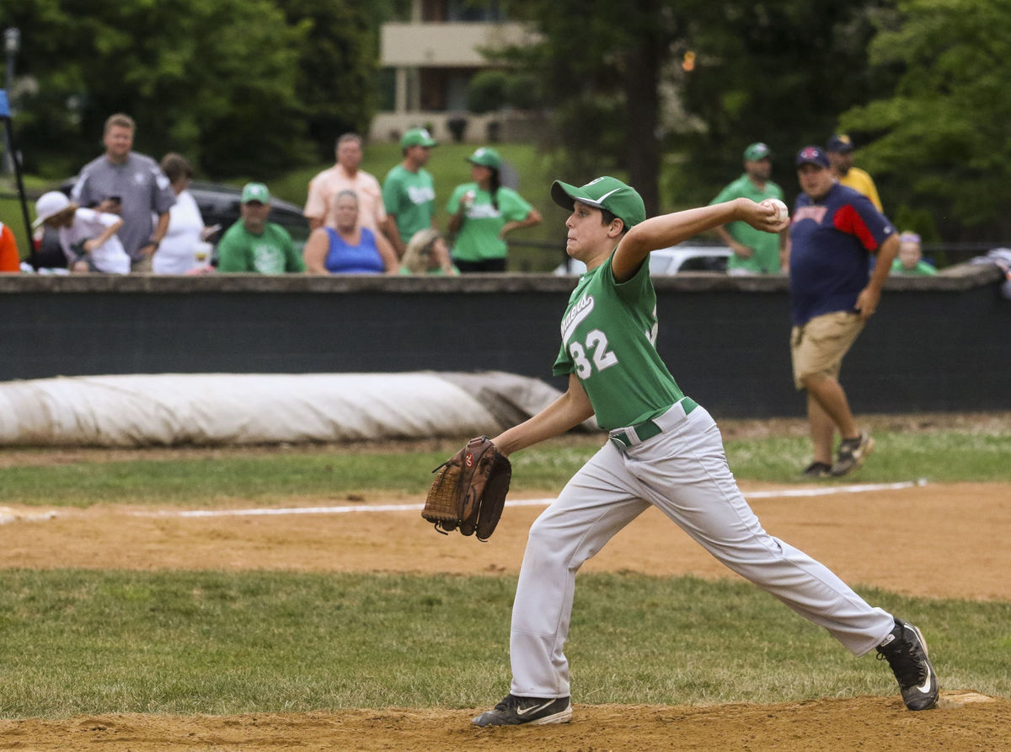
Disadvantages of Specialization
Burnout
Social isolation
Withdrawal from sports
Lack of fun at earlier ages
Performance pressure in older athletes
Increased risk of injury
Undermines the development of a wide range of comprehensive motor skills which may be helpful for injury prevention.

Slide 9
Baseball in the Age of Specialization
Approximately 5 million children ages 6-17yo participate in organized youth baseball leagues in the US
Since 1990s, increase in independent baseball and travel teams
Typically for pitchers, talent recognition occurs in the latter years of high school (ages 15-18).
Peak performance in mid-late 20s
Retirement before age 40
In the 21st century, approximately ¼ of UCL surgeries are performed on youth or high school pitchers

Slide 10
Biomechanics of Pitching
6 phases of throwing
Acceleration: 40-50msec, up to 600,000 deg/sec
Deceleration: 50msec, up to 500,000 deg/sec

Slide 11
Biomechanics of Pitching
Adults
Elbow valgus stress ~ 65 Nm, highest during cocking
Shoulder tensile stress ~ 1,100 Nm, highest during release

Slide 12
Little Leaguer’s Shoulder
Proximal humeral epiphysitis
Salter Harris type 1 physeal injury
Occurs most commonly between 11 and 16 years old
Most prominent symptom is lateral arm pain in the upper arm when throwing

Slide 13
Little Leaguer’s Shoulder Diagnosis
Tenderness to palpation around the upper arm and some loss of flexibility
X-rays are usually normal during the initial phase
May progress to stress fracture of the proximal humeral growth plate
Loss of range of motion and global muscle weakness

Slide 14
Little Leaguer’s Shoulder Treatment
Initial treatment is immediate restriction from activities
6-8 weeks
Gradual return to play
Truncal core strengthening and isometric upper extremity exercises

Slide 15
Guidelines for Youth Pitchers
No competitive baseball pitching for at least 4 months per year
Pitch no more than 100 innings per year
Avoid pitching on multiple teams with overlapping seasons
Do not play both pitcher and catcher
Play other sports
Discontinue pitching if complaints of elbow or shoulder pain

Slide 16
Pitch counts and Days of Rest
Age of Athlete | Pitch Limits Per Day
10 & under | 75
11-12 | 85
13-16 | 95
17-18 | 105
Number of Pitches Thrown | Days of Rest
1-20 | 0
21-40 | 1
41-60 | 2
60+ | 3

Slide 17
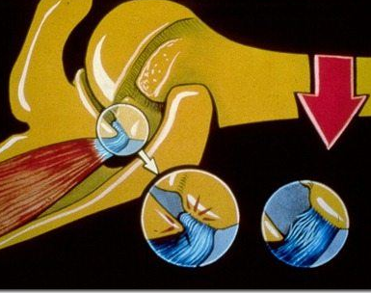
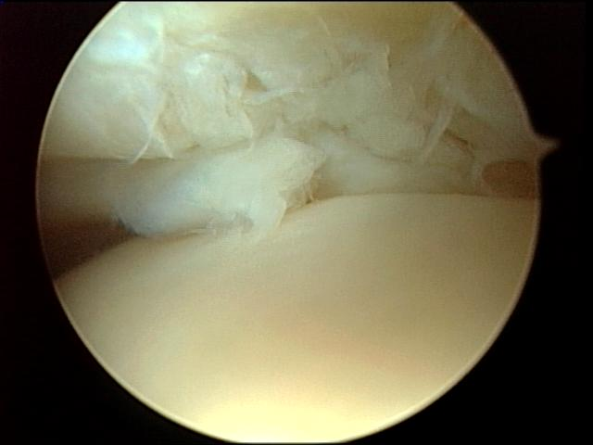
Internal Impingement
Impingement between greater tuberosity and posterosuperior glenoid rim with shoulder in cocked position (90° ABD and maximal ER)
Articular side posterior rotator cuff injury along with posterosuperior glenoid labrum fraying
? Full-thickness tears

Slide 18
Internal Impingement: Treatment
Non-operative
Proper throwing mechanics
Concentric and eccentric strengthening of the cuff and scapular stabilizers
Avoid stretching the anterior capsule
Arthroscopy

Slide 19
Rotator Cuff Injury
Requires some degree of increased glenohumeral motion (Jobe)
Muscle fatigue, eccentric overload
Inflammation
eventual tendon failure
Dynamic stabilizing ability compromised
Labral tears
capsular lesions
osseous changes

Slide 20
Rotator Cuff: Overuse Tendonitis
Posterior muscles
infraspinatus, teres minor
> 1 times body weight placed on shoulder joint during deceleration phase
Posterior capsulitis often precedes posterior rotator cuff tendonitits

Slide 21
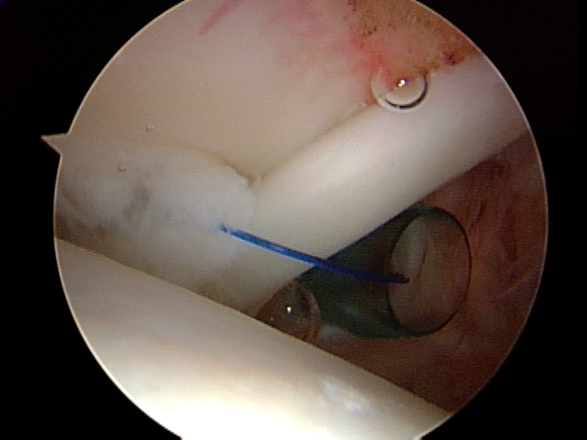
Partial RTC Tears
Tensile lesion on articular side of cuff
cuff tries to resist the ADD, IR, and GH distraction forces during deceleration
Eccentric tensile overload
partial undersurface tear forms due to repetitive microtrauma in region of supraspinatus

Slide 22
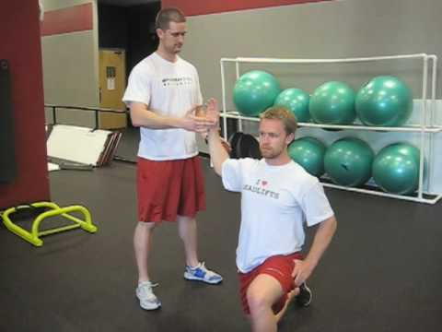
Rotator Cuff
Tenderness over supraspinatus and/or infraspinatus
Gross weakness seldom present
especially in elite thrower
Rx: rehab, rehab, rehab….
cuff strengthening
especially posterior eccentric exercises

Slide 23
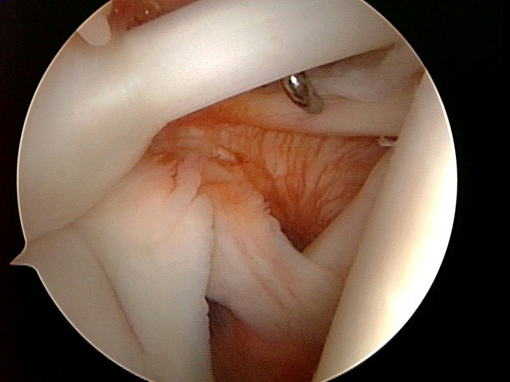
Etiology of Instability (Jobe)
Glenohumeral joint
inherently unstable
Dynamic stability
rotator cuff most important in mid-range of motion
Extremes of motion
Capsuloligamentous stabilizers (Turkel)
Repetitive, high-velocity nature of throwing leads to overuse trauma in stabilizers
Mode of failure … eccentric overload

Slide 24
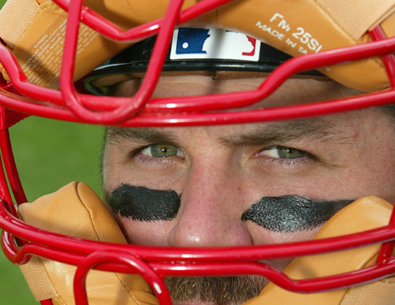
Instability
Laxity vs. Instability
Laxity
Ability of the humeral head to be translated on glenoid
Instability
Pathologic translation compromises comfort and function

Slide 25
Instability
Laxity
necessary for peak performance
Rotator cuff
dynamically controls laxity for symptom-free throwing
Excessive glenohumeral ER
extreme tension on anterior capsule, ligaments, RTC

Slide 26
Progression of Instability
Some degree common
Cocking / early acceleration phases
anterior / inferior portions of joint repetitively stressed
Laxity increases, causing labral changes
Static joint stabilizers are compromised
Dynamic stabilizers dominate
impingement, partial-thickness tears may develop

Slide 27
Treatment of Instability
Non-operative
Rehab goals
decrease stresses from throwing
normalize ROM, scapular retraction
improve dynamic stability with cuff strengthening
Gradual return to throwing when pain gone
Surgery
Must individualize…

Slide 28
Glenoid Labral Tears
Large compression and shear forces
Degenerative tears
Anterior
Posterosuperior
Frank tears
Labral detachment from the glenoid
Superior
Anterior

Slide 29
SLAP Lesions
Biceps
decelerates arm during deceleration and follow-through
only muscle to cross both the shoulder and elbow
Traction / eccentric contraction at deceleration phase
leads to avulsion tears of biceps or biceps-labral insertion
83% anterosuperior tears in 73 athletes with labral tears (Andrews)

Slide 30
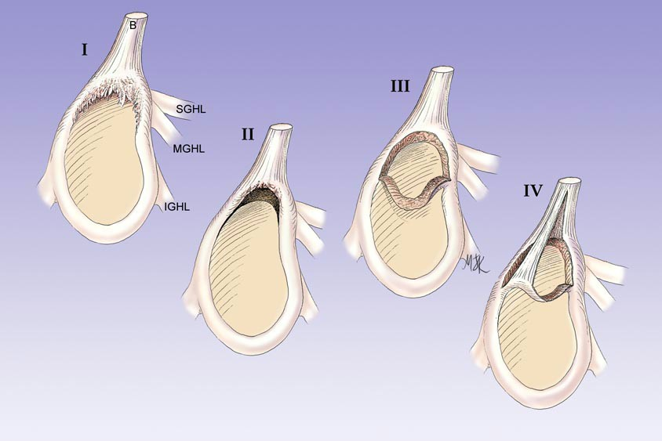
SLAP Lesions
I - superior labral fraying with no detachment
II - fraying / detachment of biceps / labral anchor
III - bucket-handle labral tear; intact biceps anchor
IV - bucket-handle labral tear; extension of tear into biceps

Slide 31
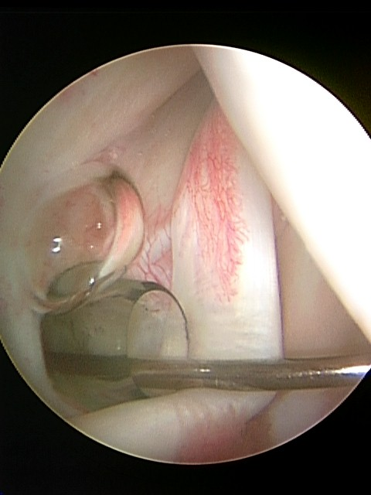
Biceps Tendonitis
Biceps activity
cocking, acceleration, and especially follow-through (Jobe)
Primarily responsible for eccentric deceleration of elbow
? Anterior stability (Rodosky)
Dx:
Tenderness
Speed’s test
Yergason’s test

Slide 32
“Little Leaguer’s Elbow”
Brogdon and Crow, Am J Roentgenol, 1960.
Nonspecific term
Applied to a number of different clinical entities
More specific diagnosis preferred

Slide 33
Little League Elbow
Medial epicondyle apophysitis
Most commonly occurs in pitchers, but may also occur in other overhead or throwing sports
Valgus overload or overstress injury

Slide 34
Anatomy
Skeletal considerations
Children = small adults
Presence of secondary ossification centers
Physeal stress injuries
50% stability
Medial ligaments
Anterior bundle (1º <90º)
Posterior bundle (1º >90º)
Transverse ligament
Tensile forces medial, compressive lateral

Slide 35
Physical Examination
Valgus instability
Anterior bundle (A)
Elbow flexed 20-30º
Valgus stress
Posterior bundle (B)
Elbow flexed 90º, forearm supinated
Pull outward on thumb

Slide 36
Little League Elbow
Diagnosis
Treatment
Pain on the medial (inner) side of the elbow when throwing
Difficulty fully extending the elbow
Tenderness over the medial epicondyle
Often normal X-rays
Rest, rest, rest
6-8 weeks
Apply ice to help with swelling
Refine throwing technique
Strengthening arm, upper back, and core muscles

Slide 37
Tommy John Surgery

Slide 38
“Osteochondritis Dessicans”
Ages 10 – 14 years
Repetitive compression loading + vulnerable chondroepiphyseal blood supply → abnormalities in osteochondral surface
Presentation
Pain, stiffness
Loose bodies → catching, locking

Slide 39
“Osteochondritis Dessicans”
Diagnosis
Radiographs
MRI
Classification
Multiple
Radiographic, arthroscopic
Defilice et al., 2001
Keys: cartilage integrity, fragment stability

Slide 40
“Osteochondritis Dessicans”
Treatment
Stable lesion
Rest, NSAIDs, PT
Drilling in situ
Unstable lesion
Arthroscopy vs. arthrotomy
Debridement
Internal fixation
Loose body excision
Marrow stimulation

Slide 41
Panner’s Disease
Panner, Acta Radiol, 1927.
<10 years of age
Fissuring → irregulatiry → fragmentation → reossification → remodeling, resolution of symptoms
Entire capitellar involvement
Self-limiting
“Perthes of the elbow”

Slide 42
Olecranon Apophysitis
Traction apophysitis due to repetitive forceful extension
Diagnosis: PE, XR
Treatment
Nondisplaced: rest, PT
Displaced: ORIF

Slide 43
Medial Epicondylitis
“Golfer’s elbow”
Pathophysiology
Repetitive valgus stress → inflammation of flexor-pronator origin
Diagnosis
PE, MRI
Treatment
Rest, NSAIDs, bracing
Injections?
Debridement

Slide 44
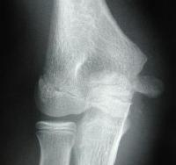
Medial Epicondyle Fracture
In skeletally immature athletes, may have physeal injury/avulsion
Diagnosis: XR, MRI
Physeal widening
Treatment
Nondisplaced: rest, PT
Displaced: ORIF?

Slide 45
Ulnar Neuropathy
Pathophysiology
Traction, compression, mechanical irritation
Diagnosis
PE: neuro, subluxation, elbow instability
EMG/NCV (dynamic)
Treatment
Rest, NSAIDs
Decompression vs. transposition
Subcutaneous
Submuscular

Slide 46
Team Approach
Coach Trainer Physician
Understand basic biomechanics of the throw
Aid in the recognition, prevention and treatment of injury

Slide 47
Thank You

